Slide 1


Slide 2
Oracle Reports Builder
Oracle Reports Builder is a Oracle Developer client tool.
It is used for creating reports based on data stored in an Oracle database.
It is designed to allow a user to take data stored in an Oracle database and create a standard report of that information in several possible forms.
Reports Builder provides eight types of reports for different purposes.
Reports Builder Applications have an extension “rdf”

Slide 3
Topics
Features of the Report Builder
Defining a data model for a report
Specifying the layout of the report
Specifying a runtime parameter form for a report
Using the Oracle reports interface
Using the Reports Wizard
Changing report attributes
Creating manual reports
Creating master-detail reports
Creating parameterized reports
Running a report from a form

Slide 4
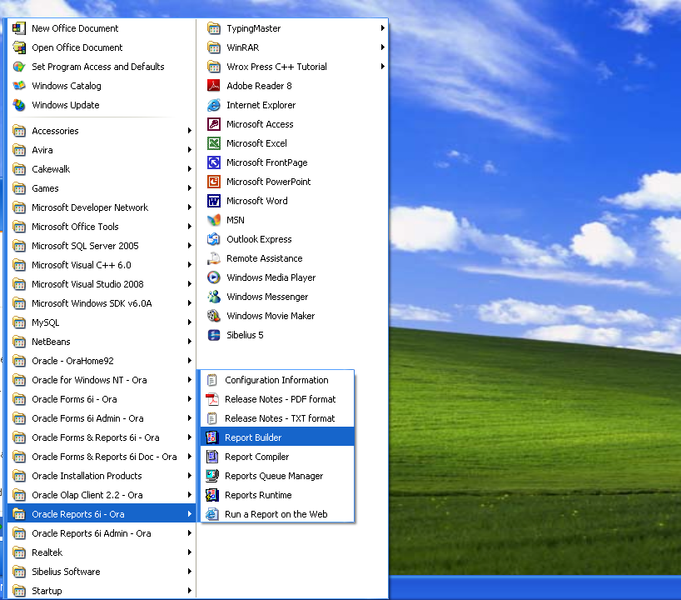

Slide 5
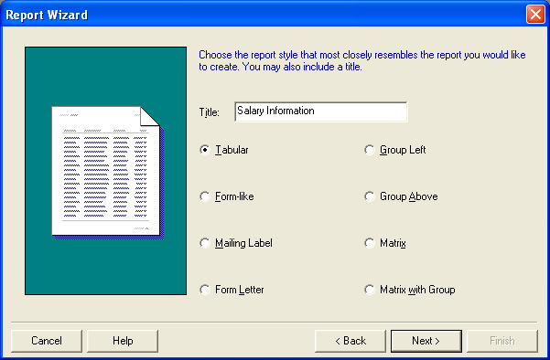
Types of Report

Slide 6
Types of Report
A tabular report is the most basic type of report. Each column corresponds to a column selected from the database.
A form-like report displays one record per page, inserting field values to the right of field labels.
A mailing label report prints mailing labels in multiple columns on each page. You can print the labels across the page and then down, or down and then across.
A form letter report contains database values embedded in boilerplate text. (Boilerplate text is any text that you enter or import into a Report Editor).

Slide 7
Types of Report
A matrix (crosstab) report
  contains one row of labels, one column of labels, and information in a grid format that is related to the row and column labels. A distinguishing feature of matrix reports is that the number of columns is not known until the data is fetched from the database.

Slide 8
Types of Report
The following reports are generated for queries having a group by clause. Thus, records are displayed based on a selected grouping of information
A group left report divides the rows of a table into "sets," based on a common value in one of the columns. Use this type of report to restrict a column from repeating the same value several times while values of related columns change.
A group above report contains two or more groups of data. For every value of the master group, the related values of the detail group(s) are fetched from the database.
A matrix with group report is a group above report with a separate matrix for each value of the master group.

Slide 9
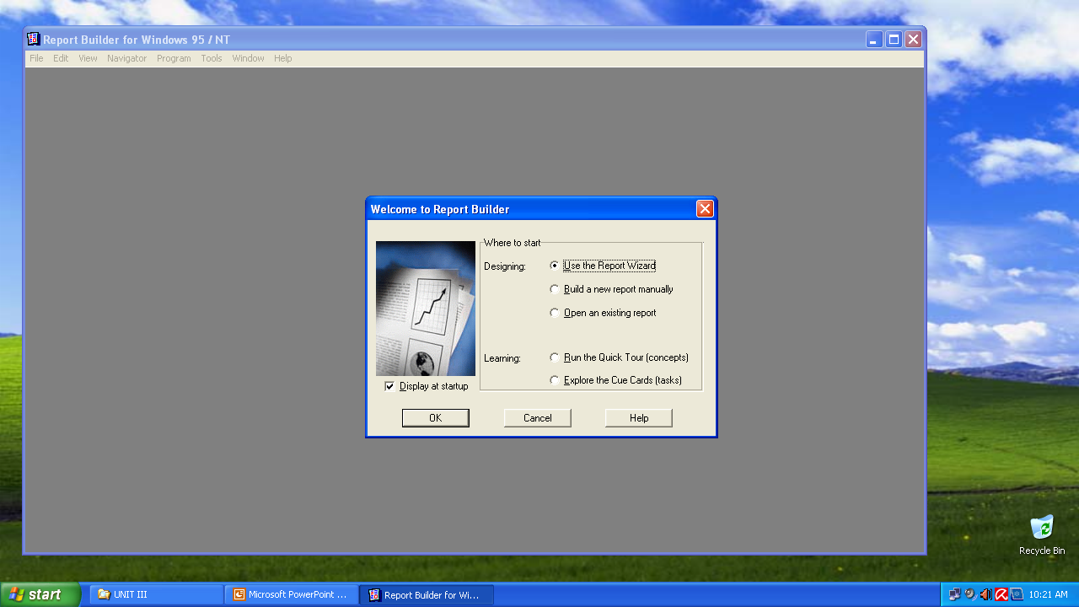
Step 1:
Open Oracle Reports 6i
Select the Report Wizard

Slide 10
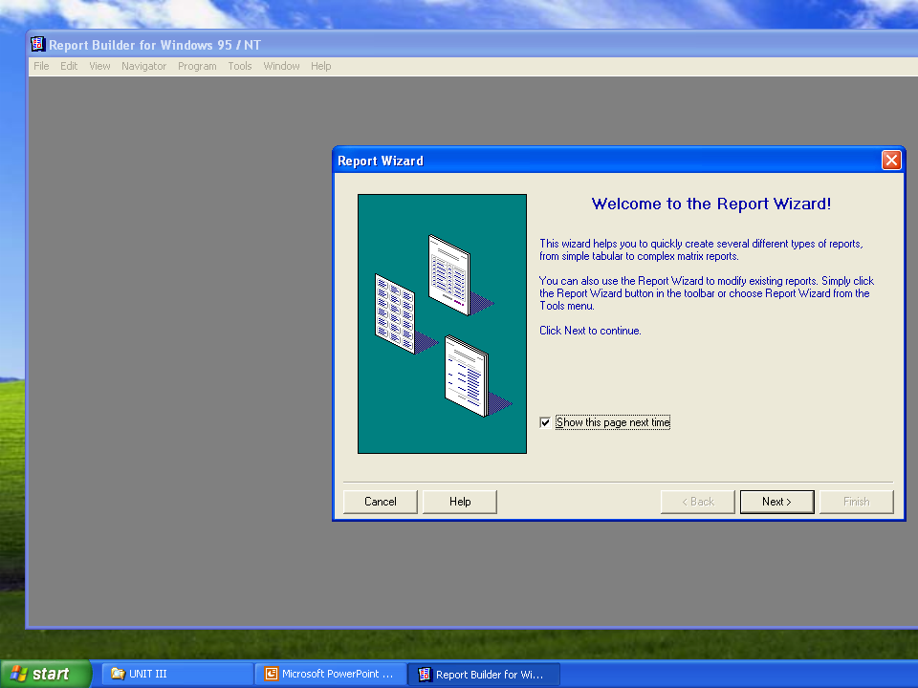

Slide 11
Step 3:
Enter Title of Report
Select Report Type

Slide 12
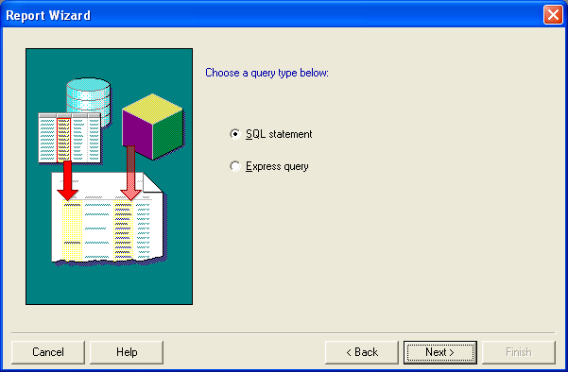
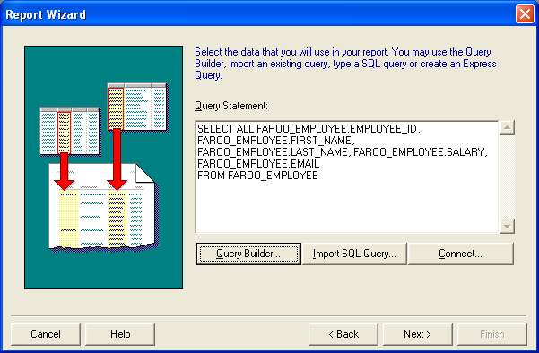
Step 4:
Select the SQL Statement
Step 5:
Create Query for generating Report Data

Slide 13
Step 6: Group Reports
If you are creating any Group Report, at this stage you must select the column(s) which will appear in the Group By Clause of the Select Statement
The column(s) must appear in the right-hand side list box titled Group Fields

Slide 14
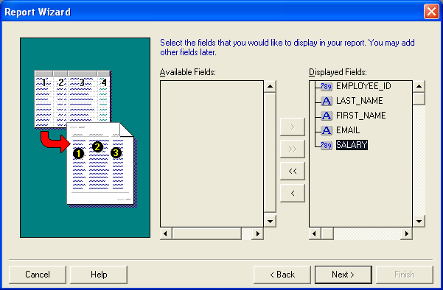
Step 7:
Select Columns to display in the report

Slide 15
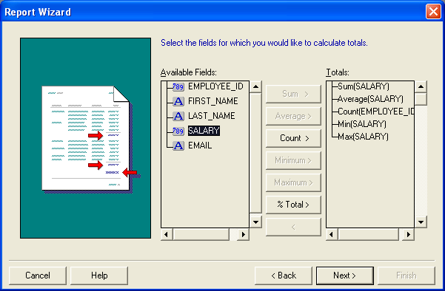
Step 8: Optional
Select Group Functions applied to any Columns to display in the report

Slide 16
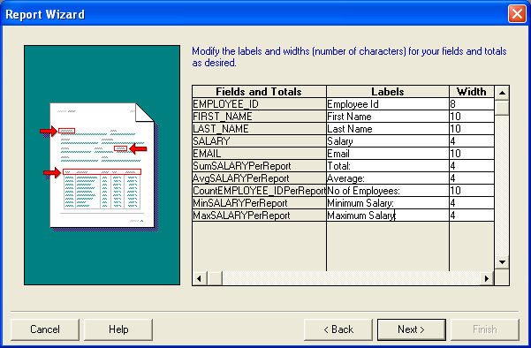
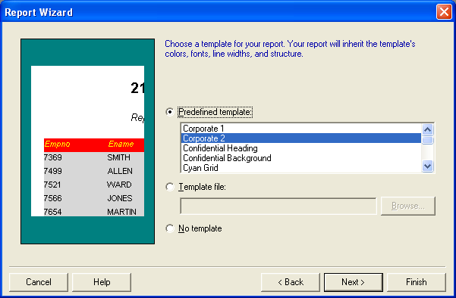
Step 9:
Click Next
Step 10:
Choose a template for your report
Click Next

Slide 17
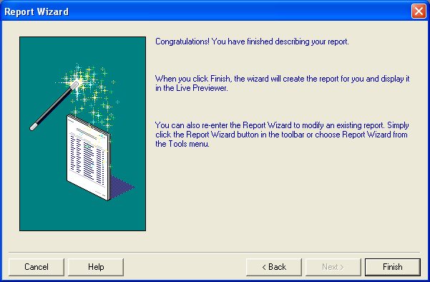
Step 11:
Click Finish
Report will be generated

Slide 18
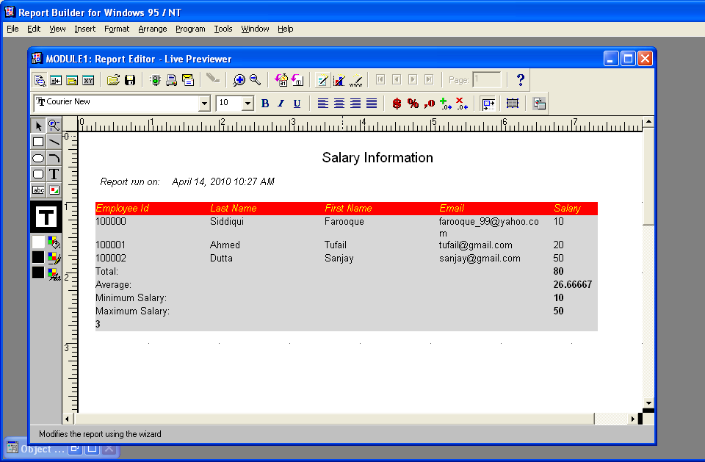
Generated Report

Slide 19
Edit a Generated Report
If you have finish creating a Report but what to modify anything, you can by
  First opening the Object Navigator (F3)
  Right click on Layout Model
  Select Report Wizard

Slide 20
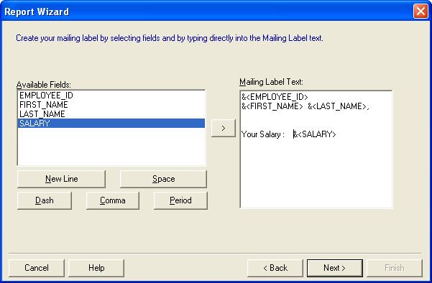
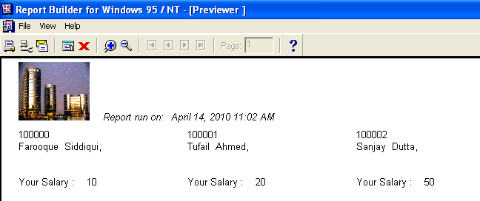
Another Type of Report: Mailing Label

Slide 21
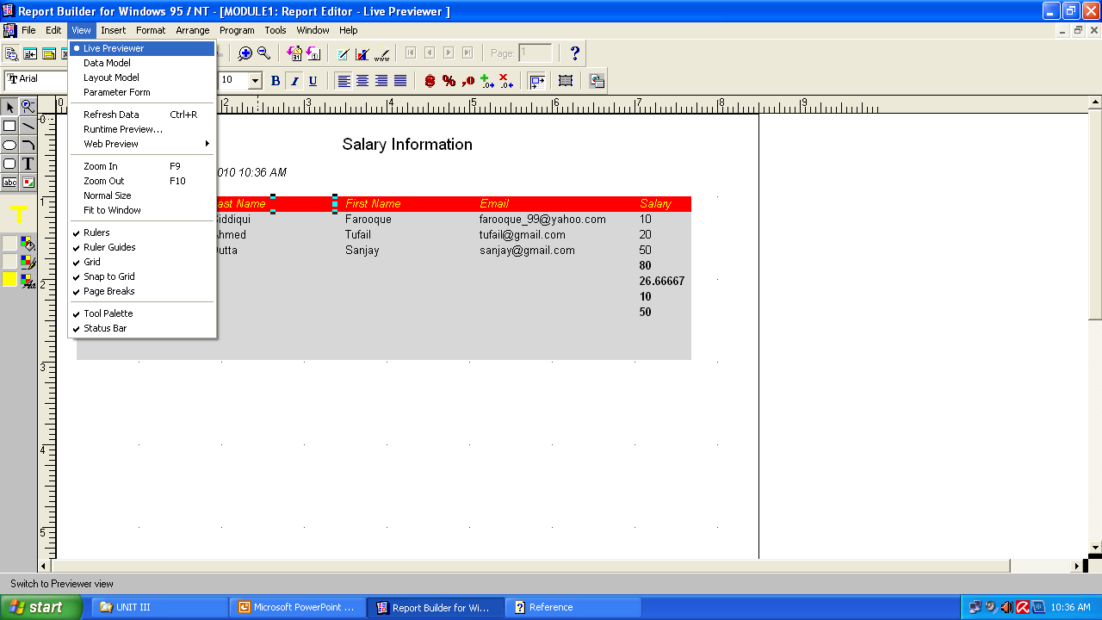
Live Previewer View
The Live Previewer is a work area in which you can preview your report and manipulate the actual, or live data at the same time.

Slide 22
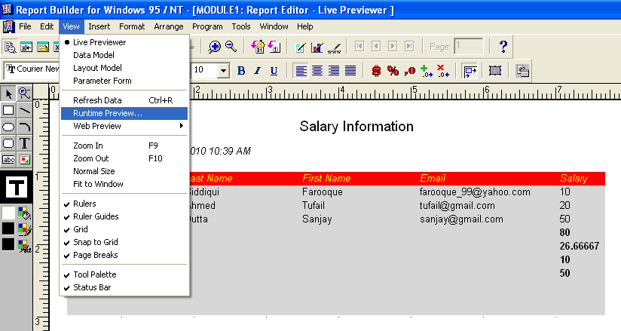
RunTime Preview…
In the Runtime Previewer, you can scroll though a single page of report output, page through the entire report, and split the screen to view different sections of the same report concurrently.

Slide 23
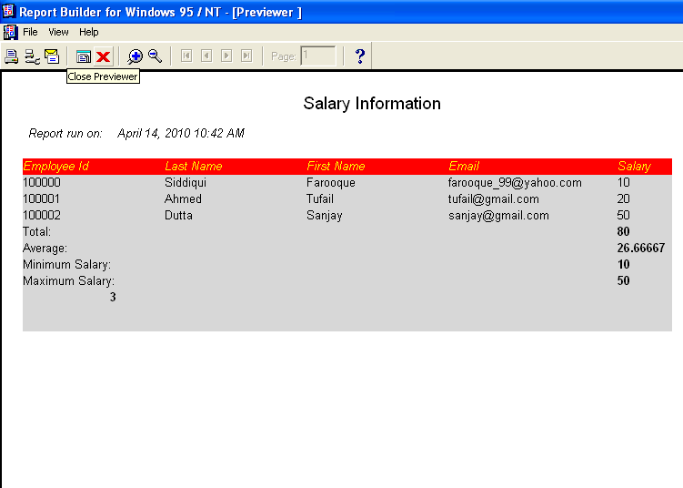

Slide 24
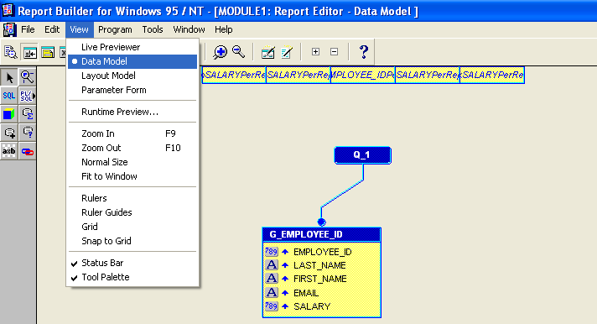
Data Model View
The Report Editor's Data Model view enables you to define and modify the data model objects for a report. In this view, objects and their property settings are represented symbolically to highlight their types and relationships.

Slide 25
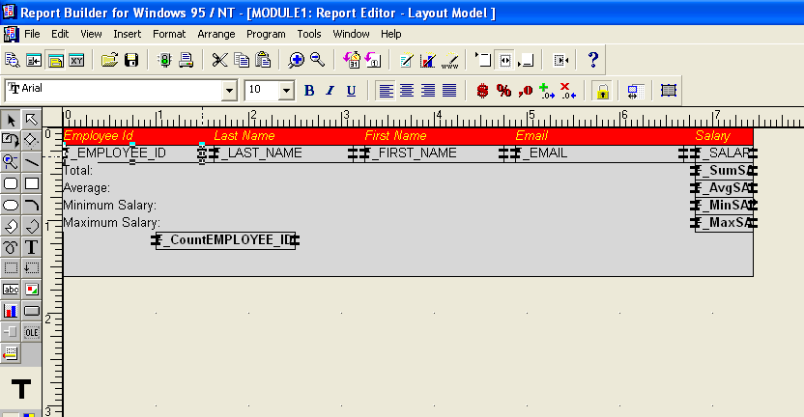
Layout Model View
The Report Editor's Layout Model view enables you to define and modify the layout model objects for a report. In this view, objects and their property settings are represented symbolically to highlight their types and relationships.

Slide 26
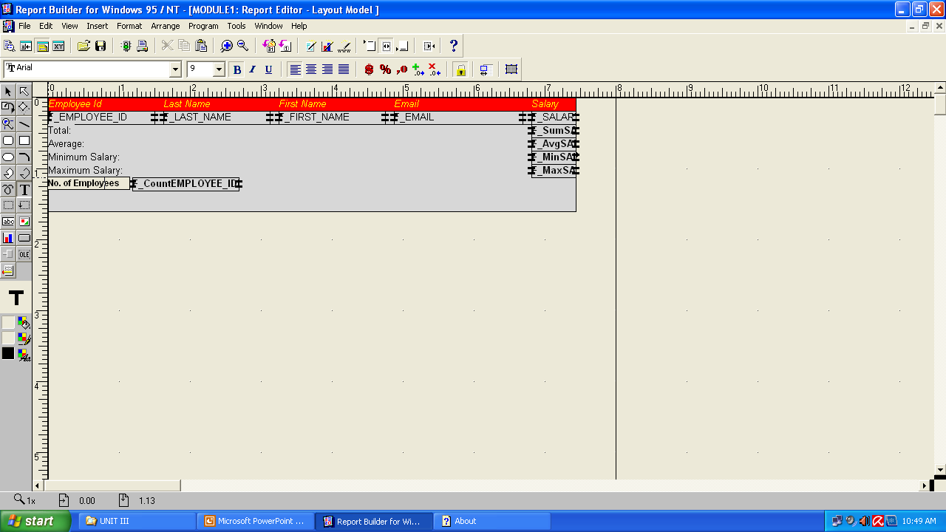
Layout Model View
Added a text with the Text tool in the Tool Palette

Slide 27
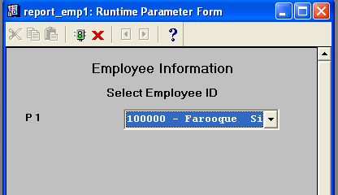
Parameter Form View
The Report Editor's Parameter Form view enables you to create a Runtime Parameter Form for your report.
You can select pre-defined system parameters for your form using the Parameter Form Builder, or you can create your own.
First we create a Report of our choice and then we create a parameter form
Select any value and Press Enter to View the Detailed Report

Slide 28
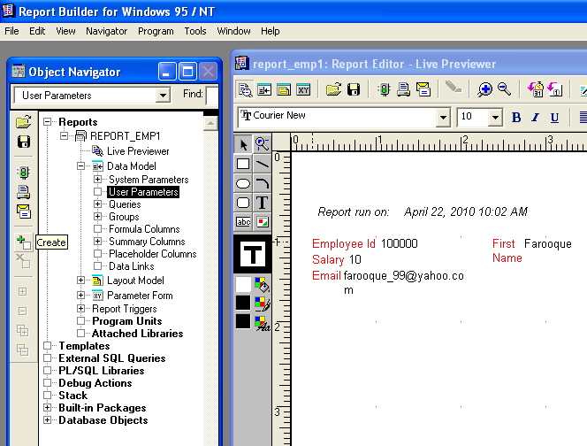
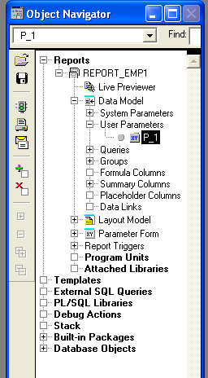

Slide 29
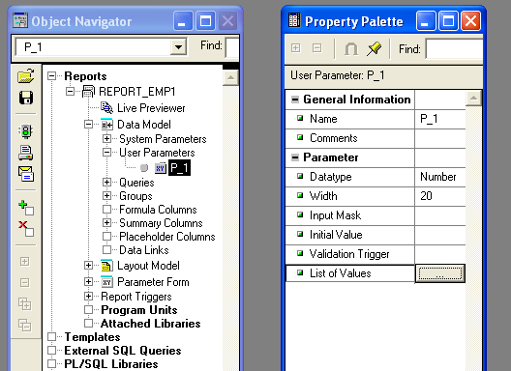
Double-Click the icon to open the property palette

Slide 30
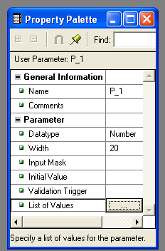
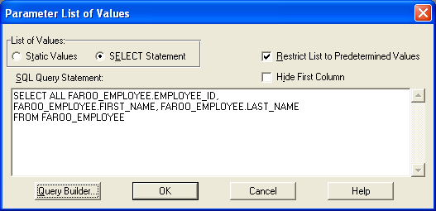

Slide 31
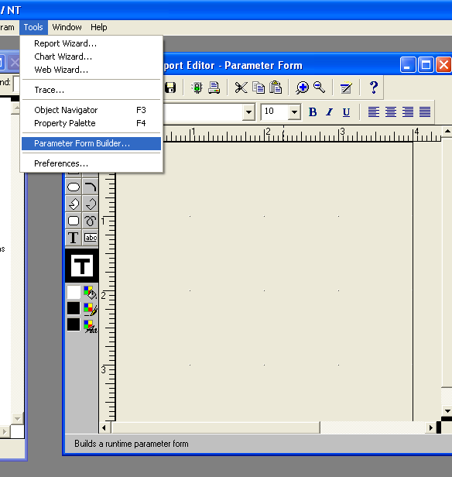
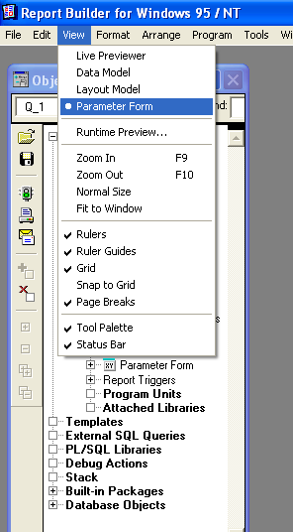

Slide 32
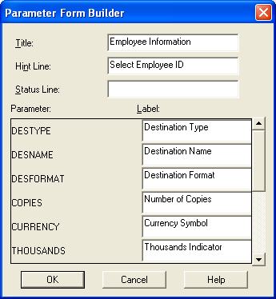
Change Values for these 2 options

Slide 33
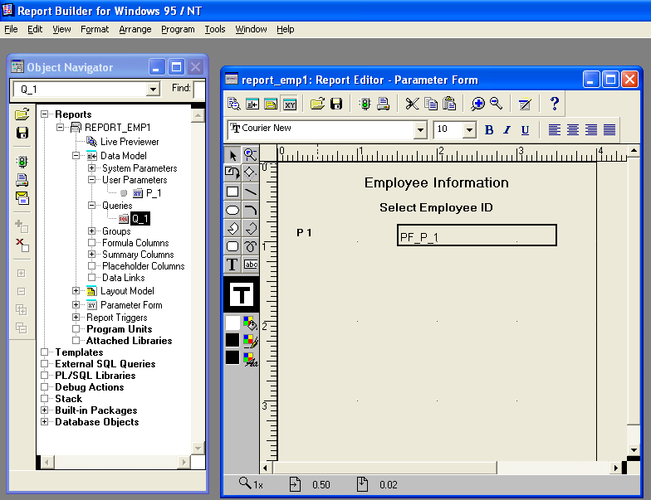

Slide 34
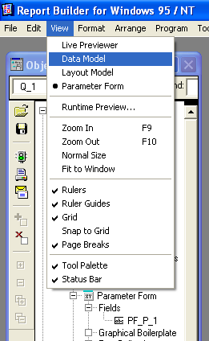
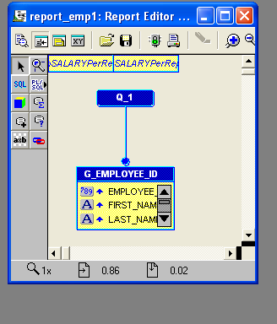
Double-Click on Query “Q_1”

Slide 35
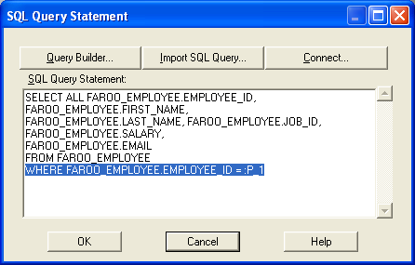

Slide 36
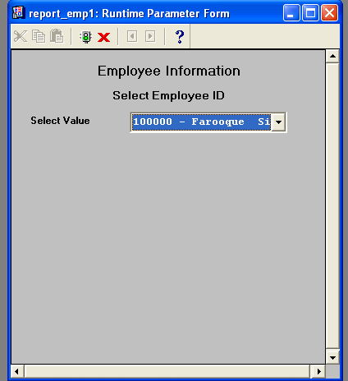
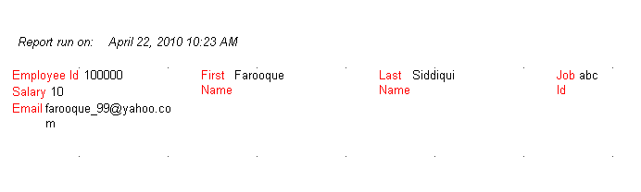
Select any Value and Press Enter to View the Detailed Report

Slide 37

Type of Report: Matrix

Slide 38
Type of Report: Matrix
Matrix Column Fields
First Name | Tufail | Sanjay | Farooque
Last Name | Ahmed | Dutta | Siddiqui
Employee ID | Salary | Salary | Salary
1001 | 10000 |  |  | 10000
 |  |  |  | 10000
1002 |  | 20000 |  | 20000
 |  |  |  | 20000
1003 |  |  | 30000 | 30000
 |  |  |  | 30000
 | 10000 | 20000 | 30000 | 60000
 | 10000 | 20000 | 30000 | 20000
Matrix Row Field

Slide 39
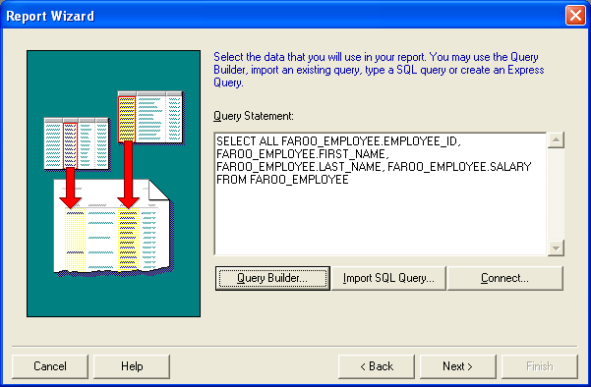

Slide 40
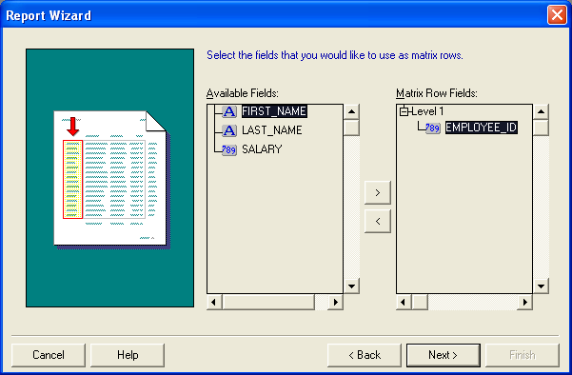
Select Matrix Row Field(s)

Slide 41
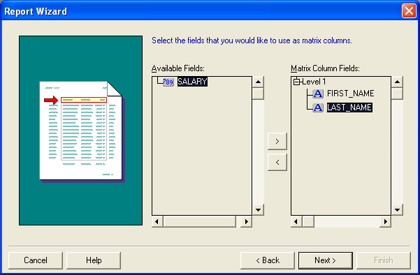
Select Matrix Column Field(s)

Slide 42
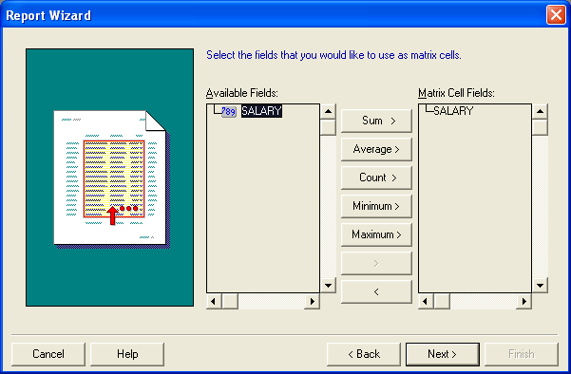
Select Matrix Cell Field(s)

Slide 43
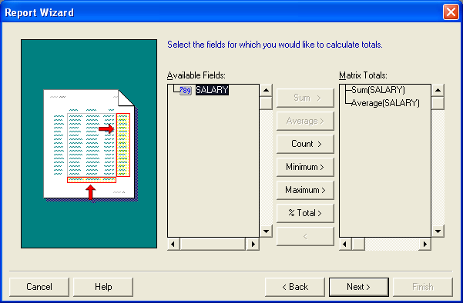

Slide 44
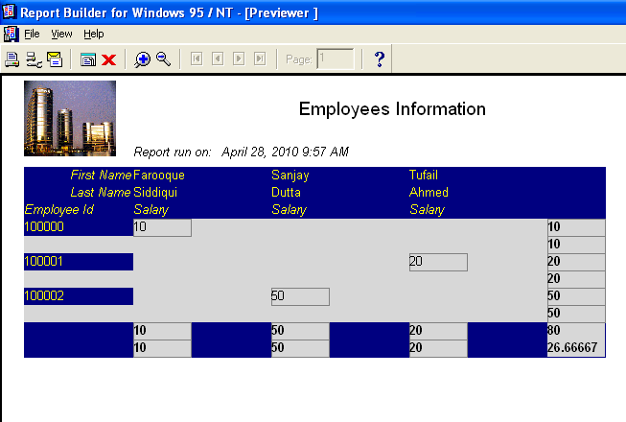

Slide 45
Parameter Form View
The Report Editor's Parameter Form view enables you to create a Runtime Parameter Form for your report.
You can select pre-defined system parameters for your form using the Parameter Form Builder, or you can create your own.
Select any value and Press Enter to View the Detailed Report

Slide 47
Double-Click the icon to open the property palette

Slide 50
Change Values for these 2 options

Slide 52
Double-Click on Query “Q_1”

Slide 53
Note** -
We modify the select query by adding a condition to retrieve the record
If there is no where clause, we write it but if WHERE clause exists, then in the very next line we write AND operator followed by the conditions

Slide 54
Select any Value and Press Enter to View the Detailed Report

Slide 55
Parameter Form with
Two or more parameters
Create User Parameter say P_1
In P_1’s property palette, check the data type and change accordingly to match the value that is being returned (By default only one column value can be returned)
Select the columns you would like to be displayed in the parameter form
Concatenate the columns into one single value, if required
  Not required ,if one of the columns is a primary key
  By default, the User Parameter will return only the value of the first column, from the list of values. If primary key present then we return its selected value. As shown in the next slide
3.

Slide 56
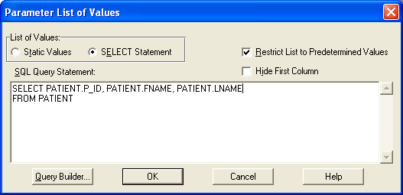
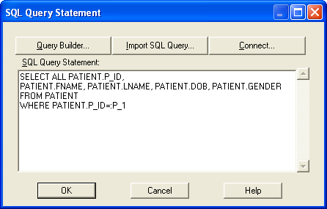
Example: Primary key with other parameters

Slide 57
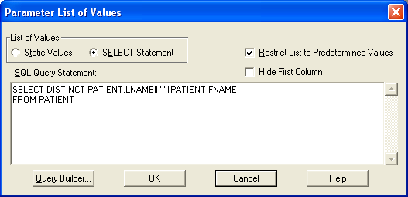
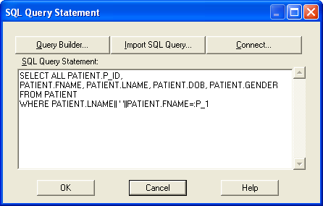
Example: Other parameters which is not Primary key or unique

Slide 58
Worksheet of Reports
Create a tabular report titled “Employee Salary Details” to display the employee id, first name, last name, email id, job id and salary. The report must also display sum, minimum, maximum, average salary as well the total number of employees. Create a parameter form which displays job id and information is displayed accordingly
Create a tabular report titled “Employee Salary Details” to display the employee id, first name, last name, email id, job id and salary. Create a parameter form which displays firstname and lastname and report is displayed accordingly

